Slide 1
Chapter 2 Configuration Space
Chapter 3 Rigid-Body Motions
Chapter 4 Forward Kinematics
Chapter 5 Velocity Kinematics and Statics
Chapter 6 Inverse Kinematics
Chapter 7 Kinematics of Closed Chains
Chapter 8 Dynamics of Open Chains
8.1 Lagrangian Formulation
Chapter 9 Trajectory Generation
Chapter 10 Motion Planning
Chapter 11 Robot Control
Chapter 12 Grasping and Manipulation
Chapter 13 Wheeled Mobile Robots

Slide 2
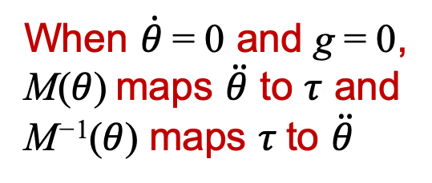
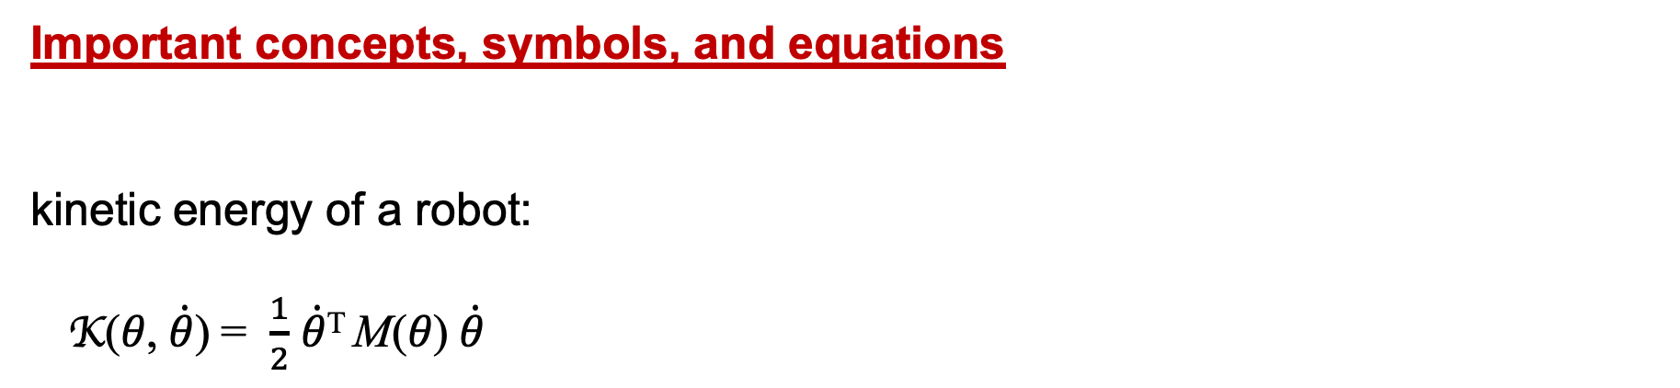

Important concepts, symbols, and equations
kinetic energy of a robot:
K(𝜃, $\dot{θ}$) = $\frac{1}{2}$ $\dot{θ}$^{T} M(𝜃) $\dot{θ}$
When $\dot{θ}$= 0 and g = 0,
M(𝜃) maps $\ddot{θ}$ to $τ$ and
M⁻¹(𝜃) maps $τ$to $\ddot{θ}$

Slide 3
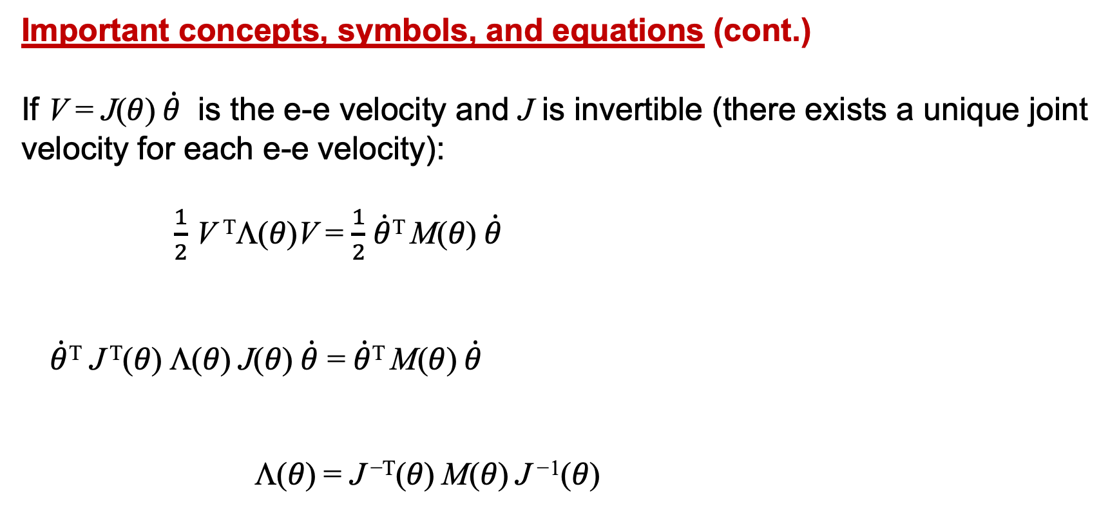

Important concepts, symbols, and equations (cont.)
If V = J(𝜃) $\dot{θ}$ is the e-e velocity and J is invertible (there exists a unique joint velocity for each e-e velocity):
$\frac{1}{2}$ V ^{T}Λ(𝜃)V = $\frac{1}{2}$ $\dot{θ}$^{T} M(𝜃) $\dot{θ}$
$\dot{θ}$^{T} J ^{T}(𝜃) Λ(𝜃) J(𝜃) $\dot{θ}$ = $\dot{θ}$^{T} M(𝜃) $\dot{θ}$
Λ(𝜃) = J ^{−T}(𝜃) M(𝜃) J ⁻¹(𝜃)
What if J is tall? wide?
end-effector mass matrix

Slide 4
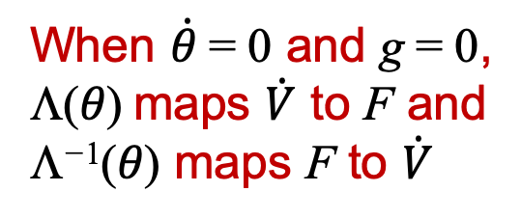


Important concepts, symbols, and equations (cont.)
When $\dot{θ}$= 0 and g = 0,
Λ(𝜃) maps $\dot{V}$ to F and
Λ⁻¹(𝜃) maps F to $\dot{V}$
Force and acceleration
are only parallel along
principal axes.

Slide 5
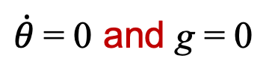
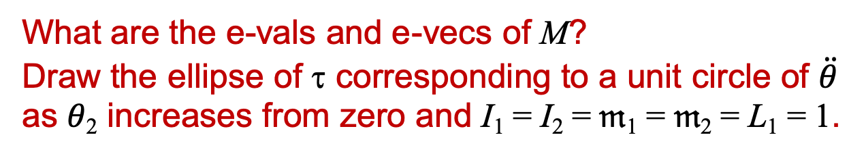
RP robot
What are the e-vals and e-vecs of M?
Draw the ellipse of τ corresponding to a unit circle of $\ddot{θ}$
as 𝜃₂ increases from zero and I₁ = I₂ = 𝔪₁ = 𝔪₂ = L₁ = 1.
$\dot{θ}$= 0 and g = 0

Slide 6
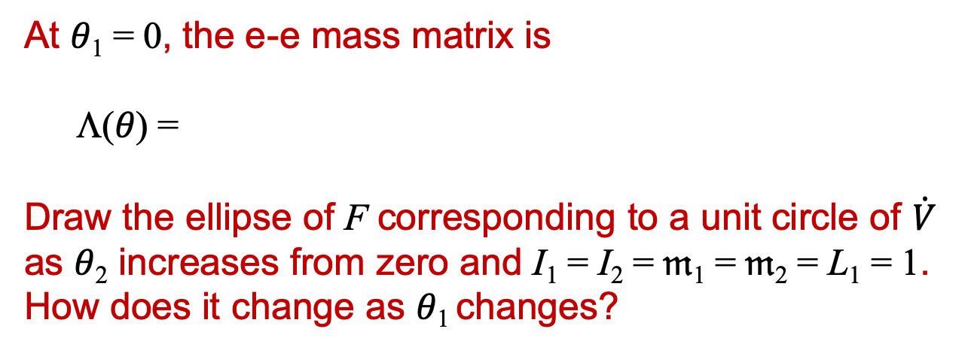
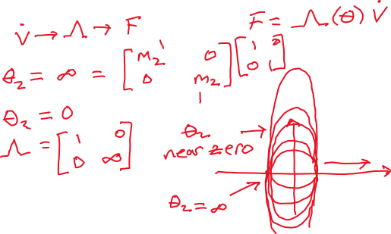
RP robot
At 𝜃₁ = 0, the e-e mass matrix is
Λ(𝜃) =
Draw the ellipse of F corresponding to a unit circle of $\dot{V}$
as 𝜃₂ increases from zero and I₁ = I₂ = 𝔪₁ = 𝔪₂ = L₁ = 1.
How does it change as 𝜃₁ changes?
V
$\dot{θ}$= 0 and g = 0

